Slide 1
Road Maintenance Complaint System
Aashutosh Sapkota
Hom Bdr. Pathak Kshetri
Abhishek Sharma
Rajeev Paudel

Slide 2
INTRODUCTION

Slide 3
1.1 Background:
Road accidents are a significant concern due to inadequate road maintenance.
Poor road conditions contribute to accidents, injuries, and loss of life.
Existing systems lack an efficient mechanism to address road-related complaints.
Our system aims to address this issue by providing a platform for reporting road conditions and maintenance needs.
By empowering citizens to actively participate, we can contribute to safer and well-maintained roads.

Slide 4
1.2 Problem Statement
1. Poor road maintenance and inadequate infrastructure in Nepal.
2. Absence of a dedicated governing body or mechanism to address road-related issues.
3. Limited government budget allocations and historical negligence leading to declining road conditions.
4. Lack of public participation and reporting framework for road complaints.
5. Proposed solution: Implementing a user-friendly road maintenance system for real-time monitoring and streamlined communication.

Slide 5
1.3 Objectives
1.To create a complaint dashboard for efficient monitoring, analysis, and decision-making in road maintenance.
2. To empower citizens by providing them with a platform to actively participate in road improvement.
3. To facilitate identifying areas requiring maintenance, repairs, or infrastructure upgrades for safer and more reliable road networks.

Slide 6
Applications and Scopes
1. Complaint submission: Users can report road complaints through the system's interface.
2. Government collaboration: Facilitating collaboration between users and government agencies.
3. Data Maintenance and analysis: Efficiently store and analyze complaint data.
4. Scalability: Capable of handling a large volume of complaints and future growth.

Slide 7
Limitation and Challenges
Verification and false reporting
Limited government response capacity

Slide 8
2. Literature Review

Slide 9
Case Study
2.1 FixMyStreet
Online platform for citizens to report and track local issues
User-friendly interface for reporting problems like potholes, streetlights, litter
Pinpoint issue location on a map, provide description
Reports forwarded to local authority for resolution
Promotes transparency by displaying reported issues and status
Encourages community engagement for local improvement

Slide 10
2.2 Roadify
Roadify: Web-based platform for road management and safety improvement
Enables citizens to report road conditions and maintenance needs
Aims to establish a transparent and efficient system
Facilitates collaboration between the public and government organizations
Focuses on enhancing road quality and preventing accidents
User-friendly interface for easy report submission and engagement

Slide 11
2.3 Street Bump
Street Bump: Innovative solution for monitoring road conditions
Utilizes smartphone sensors to collect data on road bumps and potholes
Allows citizens to contribute to road maintenance efforts
Provides real-time data for identifying areas in need of repair
Enhances road safety and improves driving experience
Collaborates with local authorities to prioritize road maintenance tasks

Slide 12
Status of Road Maintenance in Nepal
1. Inadequate road maintenance
2. Lack of timely repairs.
3. Insufficient budget for road maintenance.
4. Negligence during road construction.
5. Lack of coordination between government agencies.

Slide 13
3. Methodology

Slide 14
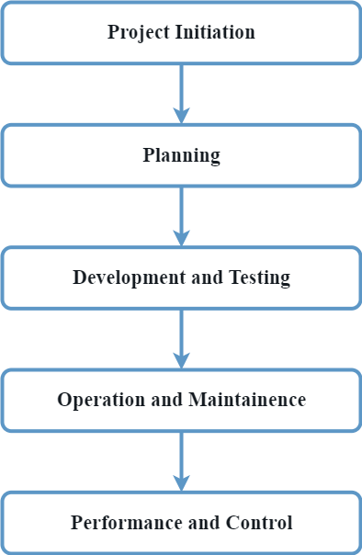
3.1 Flow Of Project

Slide 15
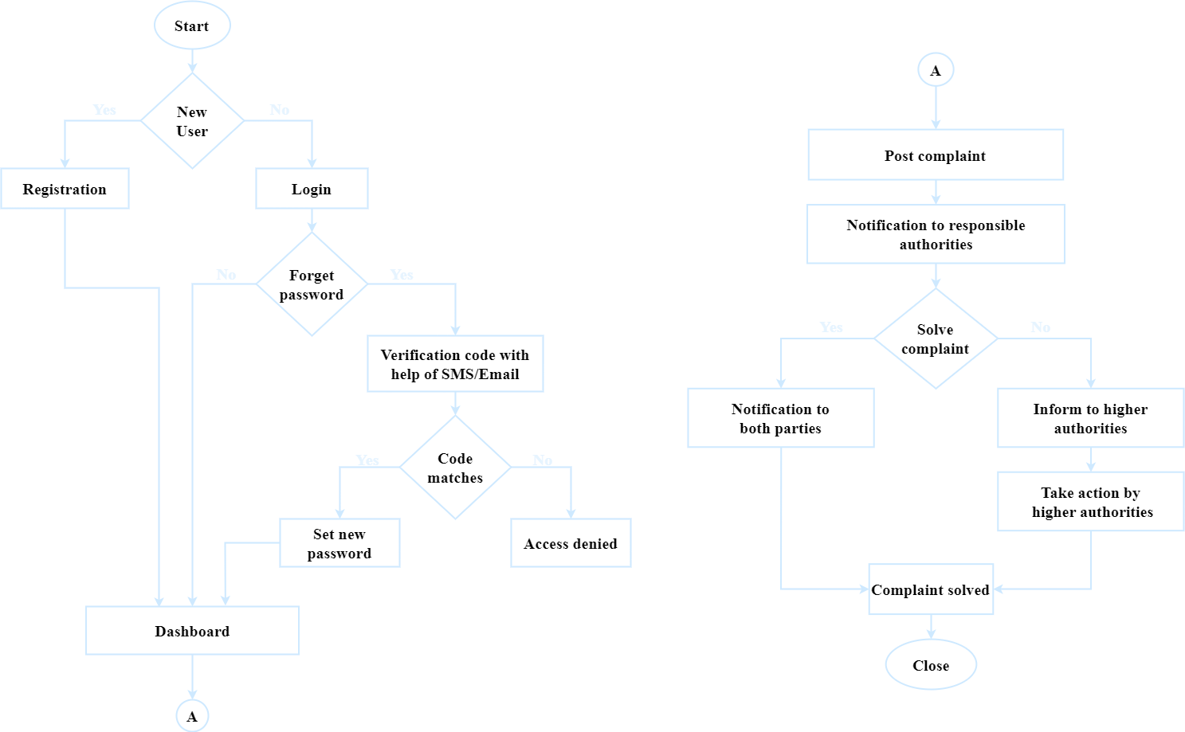
3.2 System flow
Diagram

Slide 16
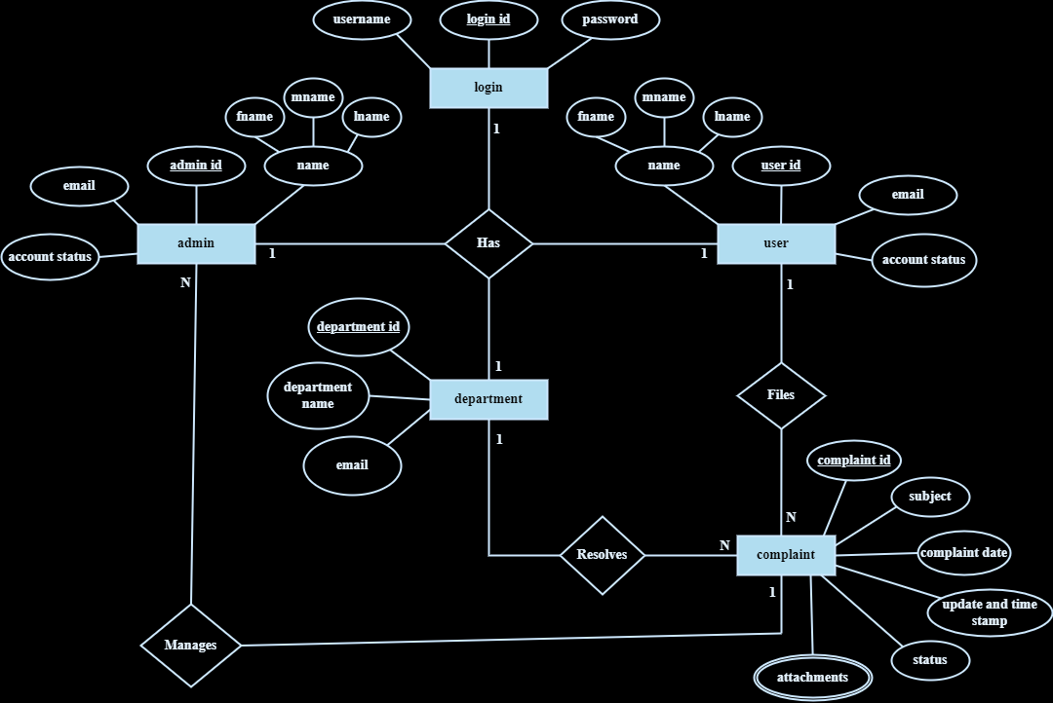
3.3 E-R Diagram

Slide 17
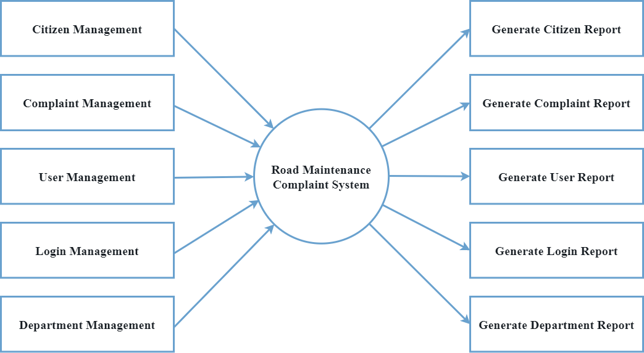
3.4 Data Flow Diagram
Level 1

Slide 18
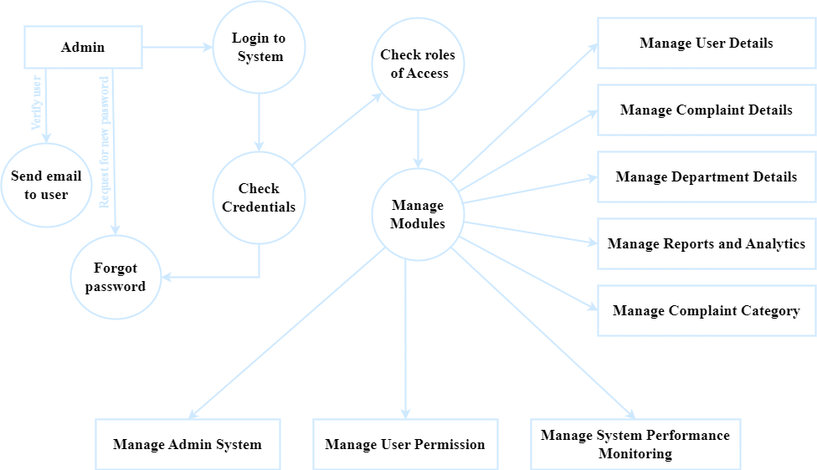
3.4 Data Flow Diagram
Level 2

Slide 19
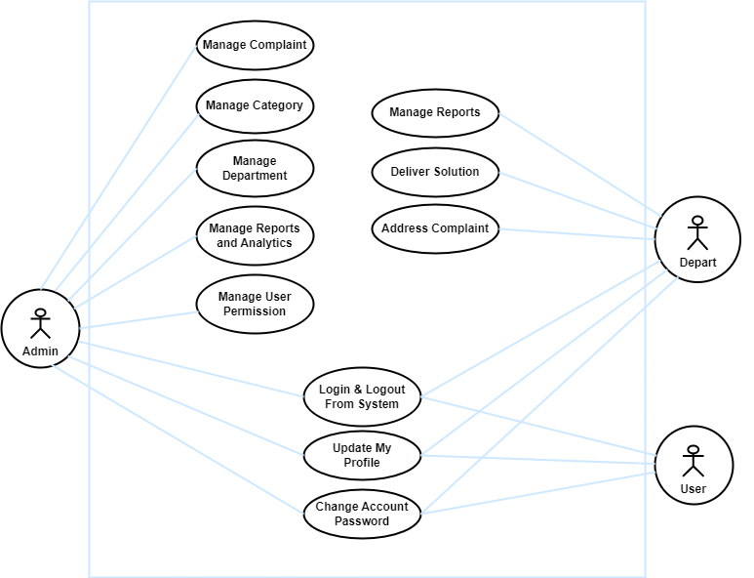
3.5 Use Case Diagram

Slide 20







Tools And Technology Used
HTML
CSS
JavaScript
PHP
MySQL
Visual Studio Code
XAMPP

Slide 21
Expected Outcome
1. Efficient Issue Reporting: Provide a user-friendly platform for citizens to report road problems promptly and accurately.
2. Timely Response: Enable authorities to respond quickly to reported issues, leading to prompt repairs and maintenance.
3. Road Safety Improvement: Address problems like potholes, damaged signs, and unsafe conditions to enhance overall road safety.
4. Data Analysis: Collect and analyze data on reported issues to gain insights for decision-making and (Trend)future infrastructure developments.
5. Community Engagement: Empower citizens to actively participate in road improvement efforts, fostering a sense of community involvement.

Slide 22
4. Epilouge

Slide 23
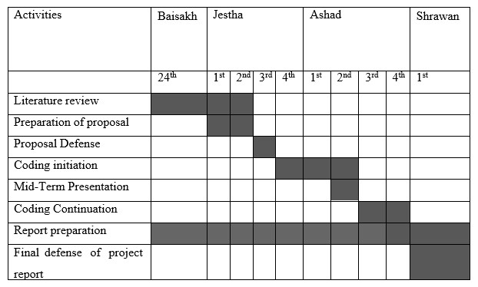
4.1 Work Schedule

Slide 24
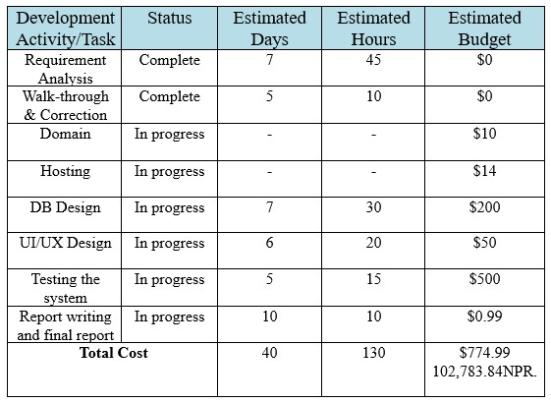
4.2 Cost Estimation

Slide 25
References
[1] D. N. Chalise, "ROADS BOARD NEPAL: A SUSTAINABLE APPROACH TO ROAD MAINTENANCE MANAGEMENT," Transport and Communications Bulletin for Asia and the Pacific, vol. I, p. 81, 2005.
[2] K. Dhakal, "Road Traffic Accidents in Kathmandu Valley," Journal of Health Promotion, 2018/11/25.
[3] K. C. B. Adhikary, "Road Traffic Accident and its Characteristics in Kathmandu Valley," JNMA; journal of the Nepal Medical Association, vol. 55, 2016.
[4] E. A. Osman Nasr, "ONLINE COMPLAINT MANAGEMENT SYSTEM," International Journal of Innovative Science, Engineering & Technology, vol. II, 2015.

Slide 26
References
[5] P. Kormpho, P. Liawsomboon, N. Phongoen and S. Pongpaichet, "Smart Complaint Management System," ICT International Student Project Conference, vol. I, p. 6, 2018.
[6] King and S. F, "Fix my street or else: using the internet to voice local public service concerns," 2007.
[7]Sagar Mahurkar, Robert Vigeant, Alexander Wald, Sean Watson, "Incorporation of the Roadify API in Ride," 2015.
[8] boston.gov, "Boston," street bumps, 1 7 2019. [Online]. Available: https://www.boston.gov/transportation/street-bump. [Accessed 22 5 2023].

Slide 27
References
[9] T. Berners-Lee and e. al, "Hypertext Markup Language (HTML)," IEEE Transactions on Communications , 1991.
[10]H. W. Lie and B. Bos, Cascading Style Sheets, IEEE Internet Computing , 1997.
[11] B. Eich, JavaScript: A High-Level, Interpreted Programming Language for Web Development, IEEE Transactions on Software Engineering, 1997.
[12] R. Lerdorf, "PHP: Personal Home Page Tools," 1996. [Online]. Available: https://www.php.net/manual/en/intro-whatis.php. [Accessed 22 5 2023].
[13] L. E. Ullman, "MySQL 8.0 Reference Manual," 2006. [Online]. Available: https://dev.mysql.com/doc/refman/8.0/en/. [Accessed 22 5 2023].

Slide 28
Thank you!
Any Queries ?

